Slide 2
PREDICT THE FUTURE SALES Under the guidance of Safa Shubbar
TEAM MEMBERS
Aswini Jemunigani(811193592) ajemunig@kent.edu
Nagasai Reddy Mala(811193871) nmala@kent.edu
Vasavi Bandari(811191559) vbandari@kent.edu

Slide 3
AGENDA
Introduction
Problem statement
Solution
Importance of Sales forecasting
Stakeholder and Constraints imposed
Software Requirements
Proposed Techniques
Methodology
Overview of the dataset
Feature description
Data preparation stage
Shape of csv files
Shop wise selling
Item category wise selling
Month wise selling
Train and Test data
Random Forest Algorithm
Code
Results
Decision tree algorithm
Code and Results
RMSE values for both models
Conclusion
References

Slide 4
INTRODUCTION
Forecasting the sales is an essential component in contemporary market intelligence and it can be very much helpful to improve the quality of business strategy.
Any business that wants to foresee its goals and alter its approach to increase sales or productivity in the future must use forecasting as a key component of its decision-making process.
For example, based on the current sales of the product, if there’s an estimation of profit in the future, we can manufacture more products. Suppose, if there’s a loss estimated, we can reduce the manufacturing of that product, so that there will be less investment and no loss.

Slide 5
PROBLEM STATEMENT
In this project, we aim to analyze the daily historical sales data owned by one of the largest Russian software firms called 1C Company by forecasting their product sales and planning them to store in the next month.
This is a Kaggle competition relating to time series prediction which will essentially focus on development and deployment of a forecasting model that relies on Machine Learning and Time-Series analysis techniques.

Slide 6
SOLUTION
The predictive model that can be precise, robust and accurate is built using machine learning techniques for predicting the sales of the 1C Company.
The machine learning algorithms like Random Forest and Decision tree are used for this purpose.
By using these two algorithms, the future sales are predicted based on past historical data and stored in next month.
Performance and accuracy is evaluated for both algorithms at the end.

Slide 7
IMPORTANT OF SALES FORECASTING
By implementing a reliable revenue predictive system
We may save spending on unneeded products.
Improve planning for the future.
Boost profit.
May help the businesses to allocate money efficiently and create a solid plan for future growth of the store.

Slide 8
STAKEHOLDER
Sai Shankar Pendem, who is currently working as a Senior AEM Developer at Citi Bank, Irving, Texas with 7+ years of experience in programming is the one who’s interested in our project.
CONSTRAINTS IMPOSED:
Cleanse the dataset properly by removing unwanted or irrelevant observations from the dataset.
Good visualizations to understand the data better.
Study the different machine learning algorithms and compare their performance and accuracy levels.

Slide 9
SOFTWARE REQUIREMENTS
Algorithms used: Random Forest and Decision Tree algorithms
Tool: Google Colabratory
Required hardware: System with 64-bit ROM and 8GB RAM.
Required Knowledge: Python Programming Language, Machine learning techniques.

Slide 10
PROPOSED TECHNIQUES
Prediction of future sales is one of the elegant machine learning study fields.
Python will be used in this project to train the machine learning model which is used to predict the sales of next month.
The dataset used in this study is from Kaggle that contains the sales of 1C Russian company from 01-01-2013 to 10-31-2015 and we are predicting the sales for 11-31-2015.
The two machine learning algorithms used for this purpose are
Random Forest
Decision Tree
Then, the performance is measured and compared by calculating the root mean squared values for the two algorithms mentioned above.

Slide 11
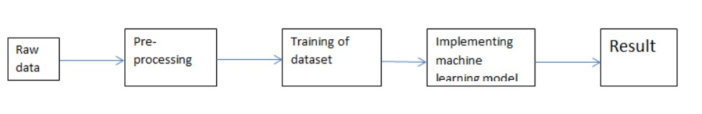
METHODOLOGY
The five steps followed in this work, right from the dataset preparation to obtaining results.

Slide 12
OVERVIEW OF DATASET
The daily historical sales stored in following csv files.
• sales_train.csv: the training set. Daily historical data from January 2013 to October 2015. • items.csv: information about the items/products. • item_categories.csv: information about the items categories. • test.csv: the test set and we need to forecast the sales for these shops and products for November 2015. (Around 2lakh records) • shops.csv: information about the shops. • sample_submission.csv - a sample submission file.

Slide 13
FEATURE DESCRIPTION
Independent variable:
item_cnt_day - number of products sold. We are predicting a monthly amount of this measure.
Dependent variables:
ID - an Id that represents a (Shop, Item) tuple within the test set.
shop_id - unique identifier of a shop.
item_id - unique identifier of a product.
item_category_id - unique identifier of item category.
item_price - current price of an item.
date - date in format dd/mm/yyyy.
date_block_num - a consecutive month number is used for convenience. January 2013 is 0, February 2013 is 1, ..., October 2015 is 33.
item_name - name of item.
shop_name - name of shop.
item_category_name - name of item category.

Slide 14

DATA PREPARATION STAGE
Basic exploration of data is done by using basic_eda() function on all the features present in order to understand the data better.
There are no missing values and no null values in the dataset.
There are 6 duplicate values in train dataset.
Excluding unwanted shop ids and item ids in train dataset.
Analyzing outliers on item_cnt_day and item_price features in train data before and after excluding the duplicates and removing them.
Cleaning shops data as there are different shop ids for same shop names like 0-57,1-58,11,10,40-39 and we don’t have 0,1,11 and 40 shop id in test data so we are replacing these with shop_id which shares a similar names.
Creating test set for month 34 and merging all the required features to it.

Slide 15
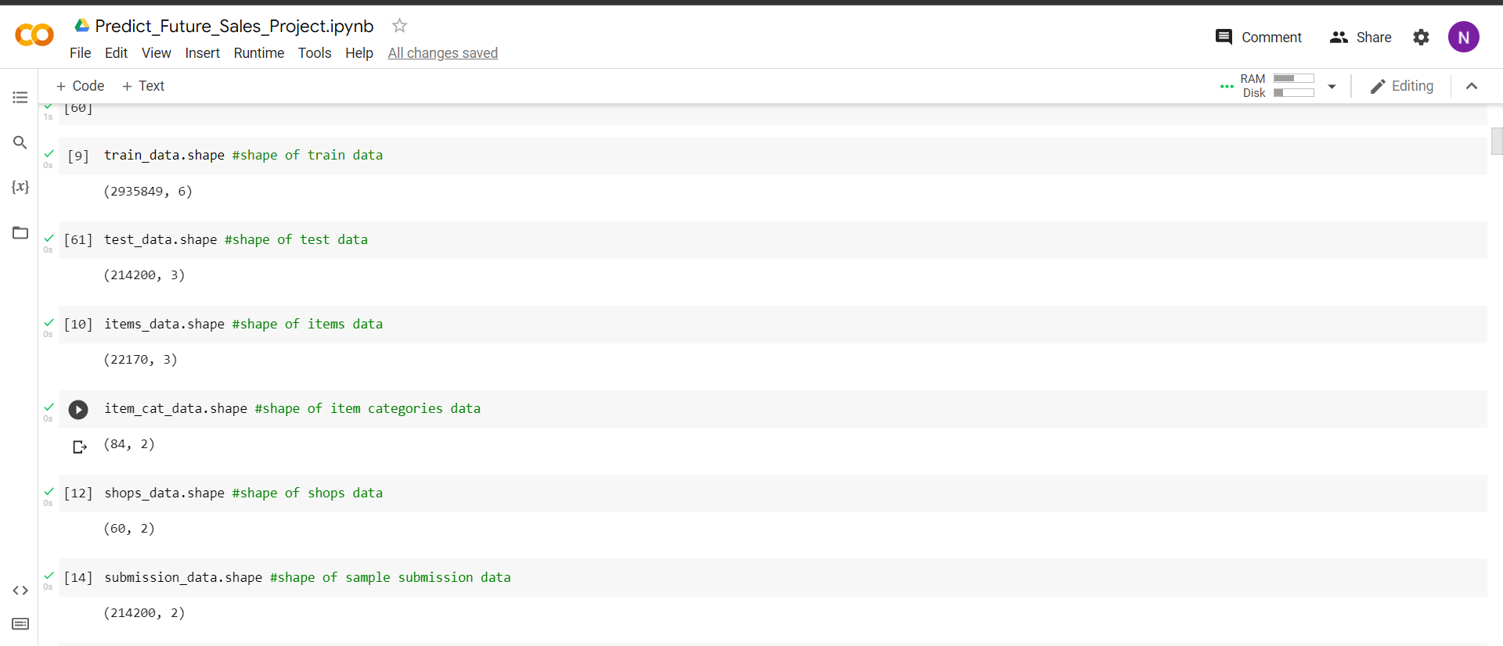
SHAPE OF CSV FILES

Slide 16
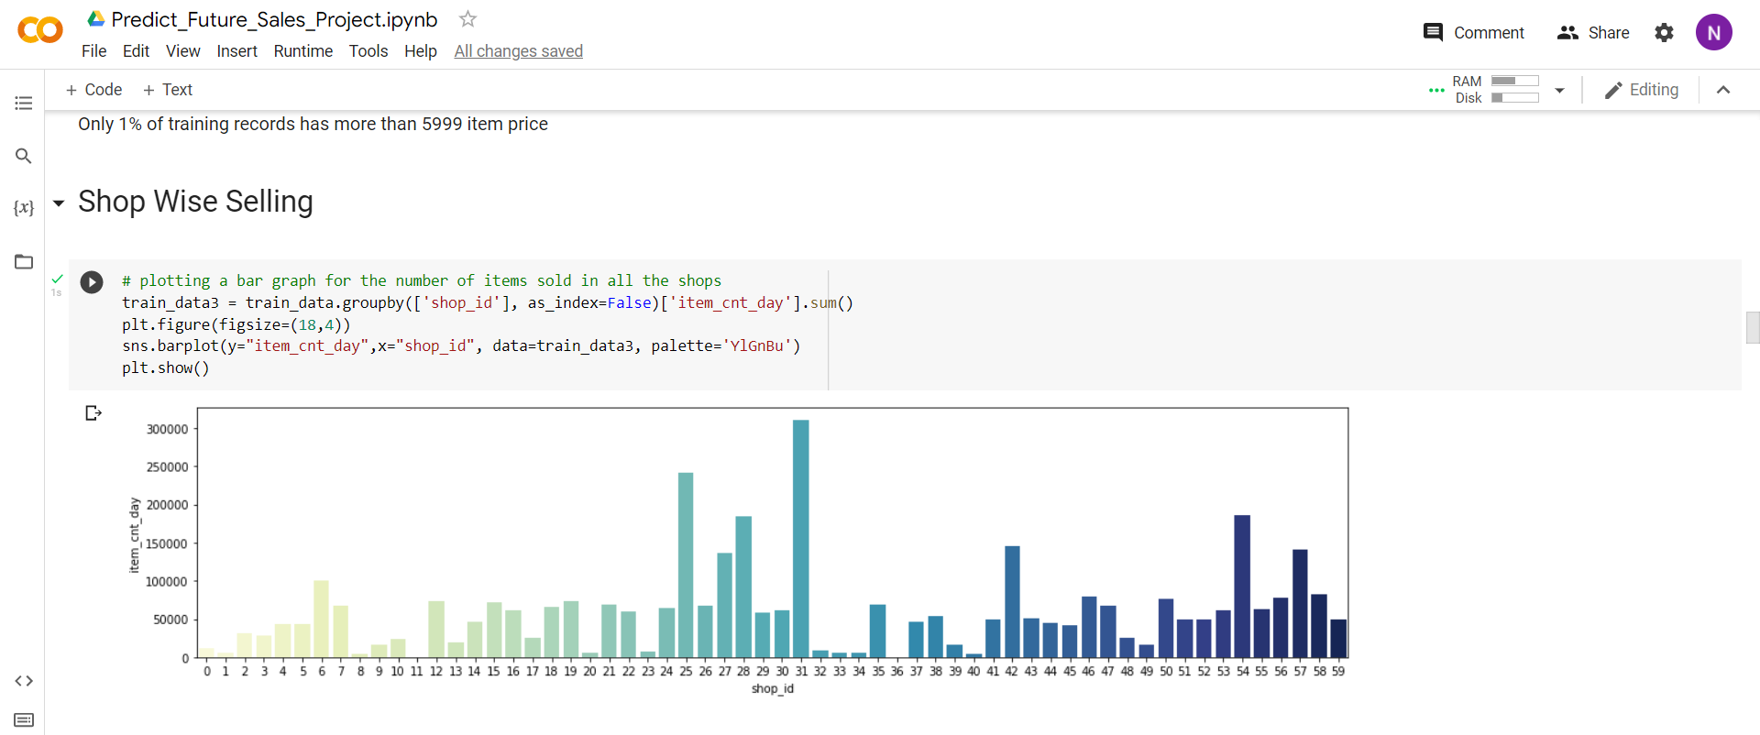
SHOP WISE SELLING

Slide 17
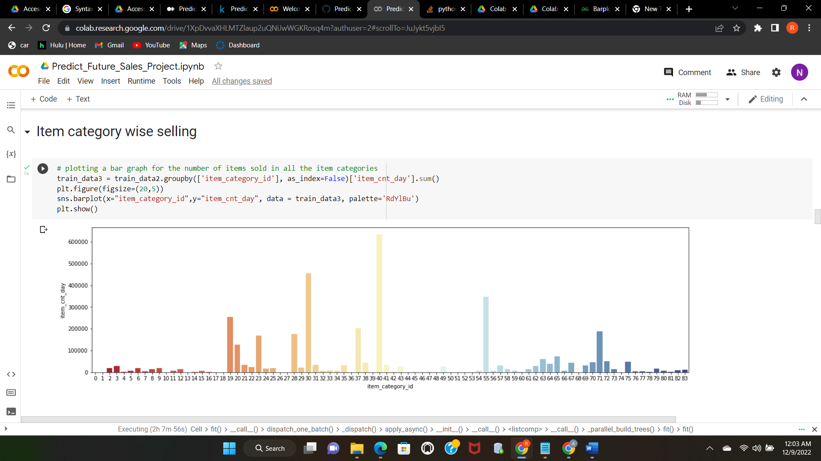
ITEM CATEGORY WISE SELLING

Slide 18
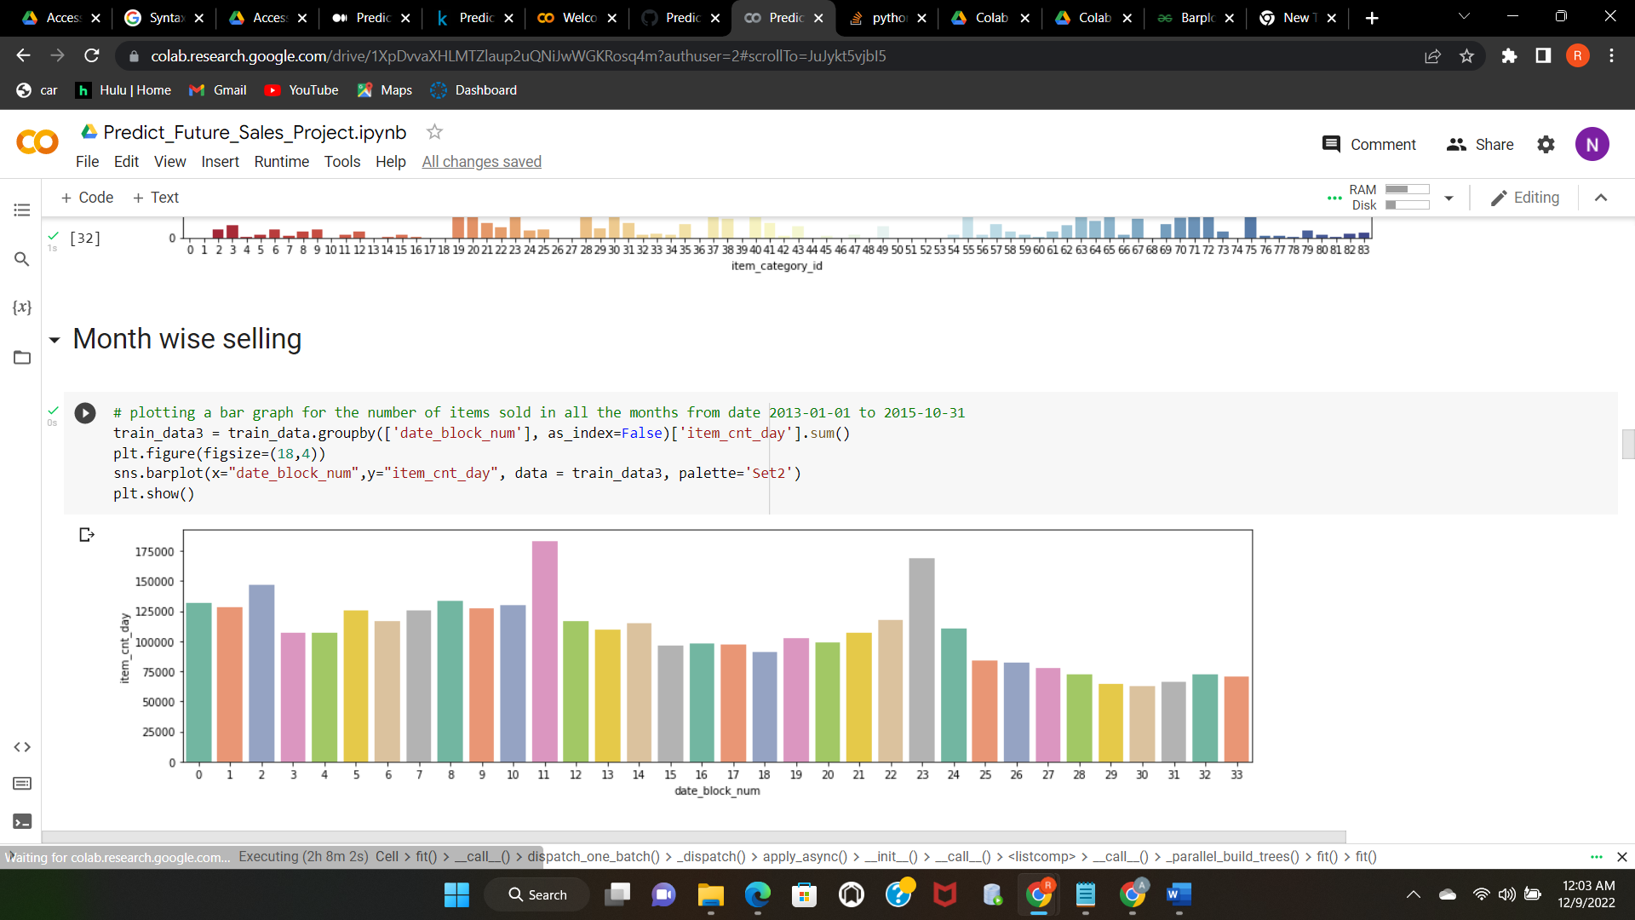
MONTH WISE SELLING

Slide 19
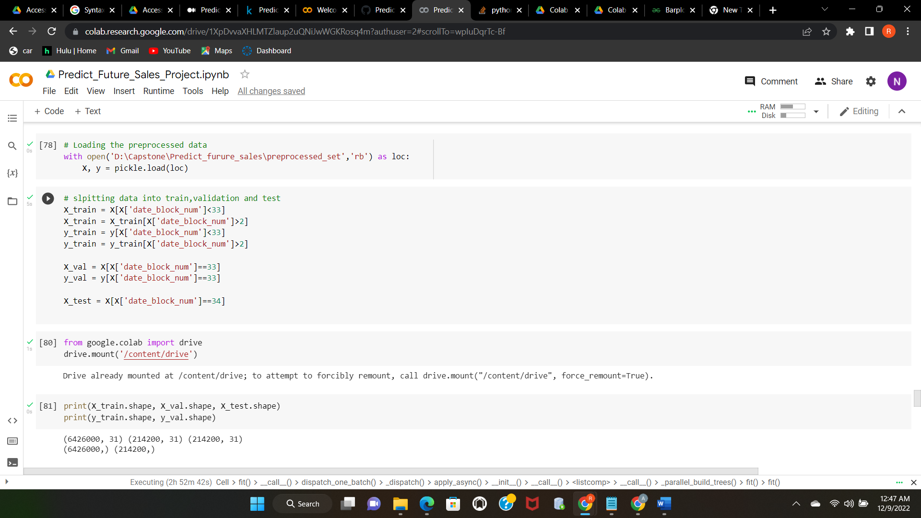
TRAIN AND TEST DATA

Slide 20
RANDOM FOREST ALGORITHM
Random Forest is an exceptionally helpful technique that can be utilized for both classification and regression problems. A "forest" is created by growing and combining various decision trees using the supervised machine learning method Random Forest.
Random Forest, as the name implies, is a classifier that uses a number of decision trees on different subsets of the provided dataset and averages them to increase the dataset's prediction accuracy.
Its foundation is the idea of ensemble learning, which is the act of mixing many classifiers to solve a challenging issue and enhance the performance of the model.

Slide 21
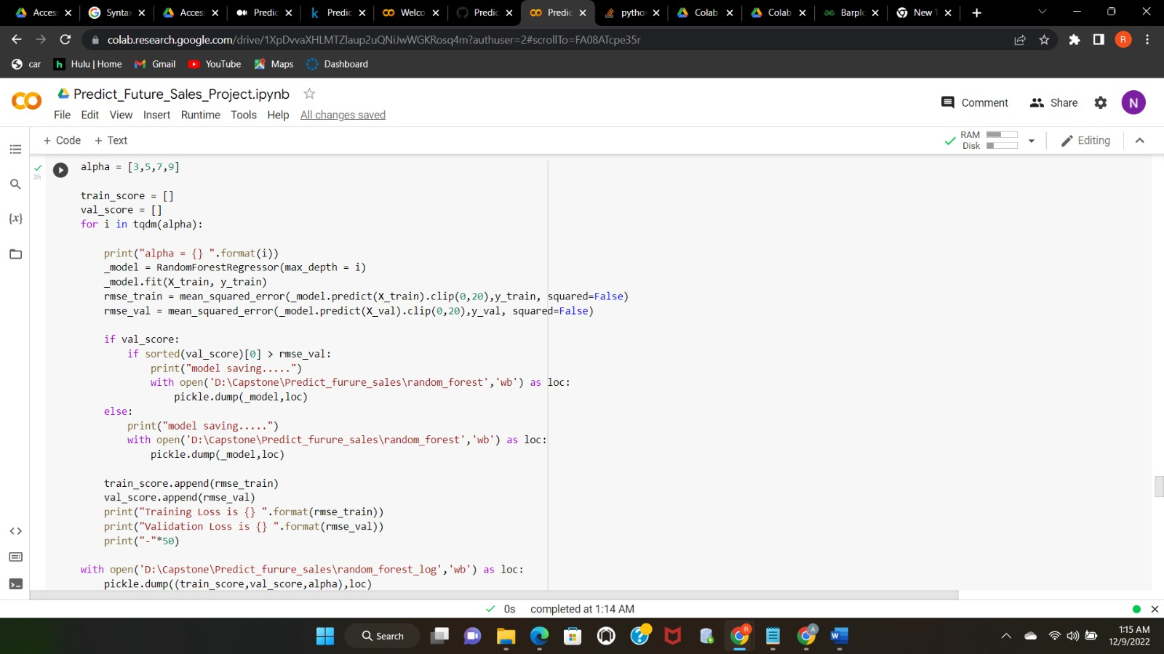
CODE

Slide 22
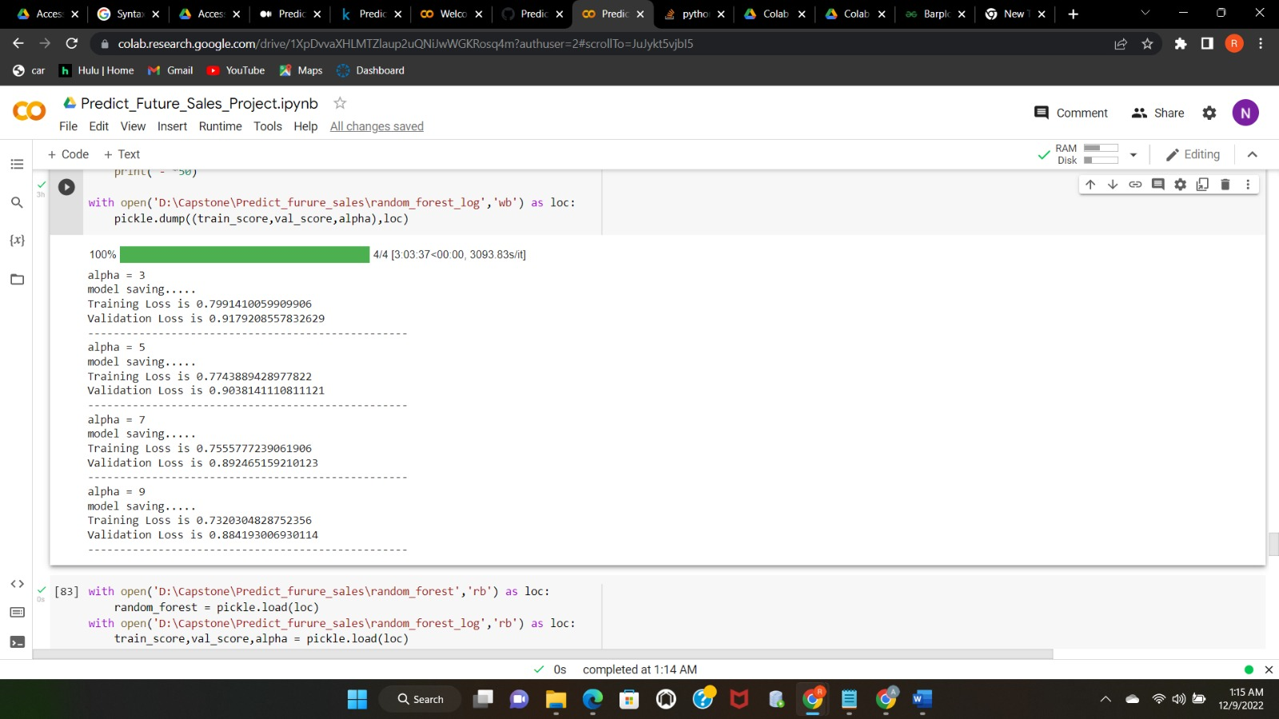
RESULTS

Slide 23
DECISION TREE ALGORITHM
In the category of supervised learning algorithms, decision tree algorithm is the best.
It is unique among supervised learning methods in that it may be applied to both classification and regression tasks.
The purpose of employing a decision tree is to develop a training model that can be used to predict the category or value of the target variable by learning straightforward choice rules learned from previous data (training data).

Slide 24

CODE

Slide 25
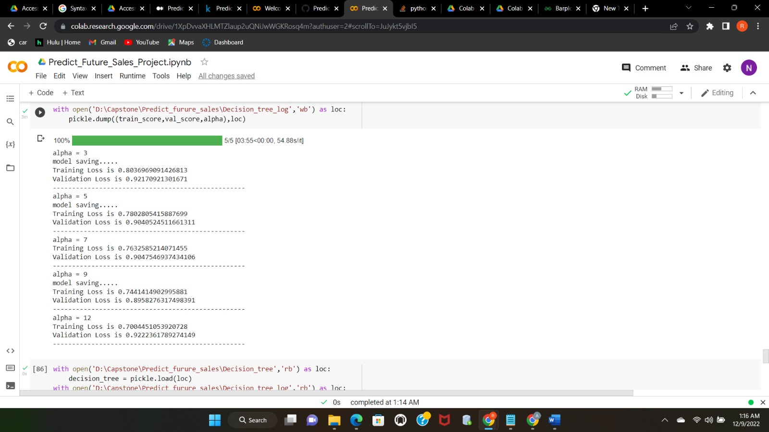
RESULTS

Slide 26
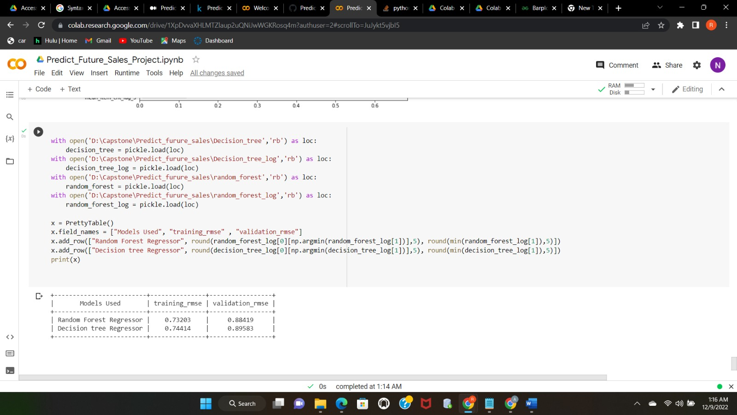
RMSE VALUES FOR BOTH MODELS

Slide 27
CONCLUSION
The two machine learning techniques are used to analyze the historical sales data using random forest and decision tree algorithms.
After the implementation of random forest regression technique to sales dataset, we obtained training loss of 79% and validation loss of 91%.
After applying decision tree regression, training loss of 80% and validation loss of 92% is obtained.
Training RMSE and Validation RMSE values are calculated for both models and compared.
Therefore, we can conclude that the decision tree algorithm works best for our sales dataset.

Slide 28
REFERNCES
https://ieeexplore.ieee.org/document/9290576
https://link.springer.com/chapter/10.1007/978-981-15-5243-4_29
https://ieeexplore.ieee.org/document/9403812
https://arxiv.org/abs/1904.09031
https://ieeexplore.ieee.org/abstract/document/9057880

Slide 29
Thank You!

